Slide 1

Trends in Front End development

Slide 2
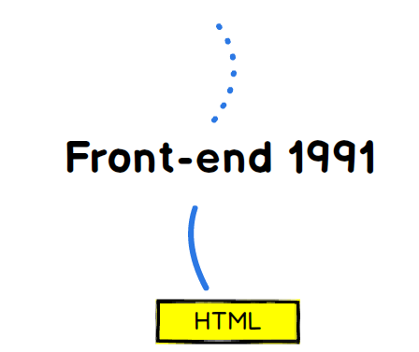
WEB STARTED

Slide 3
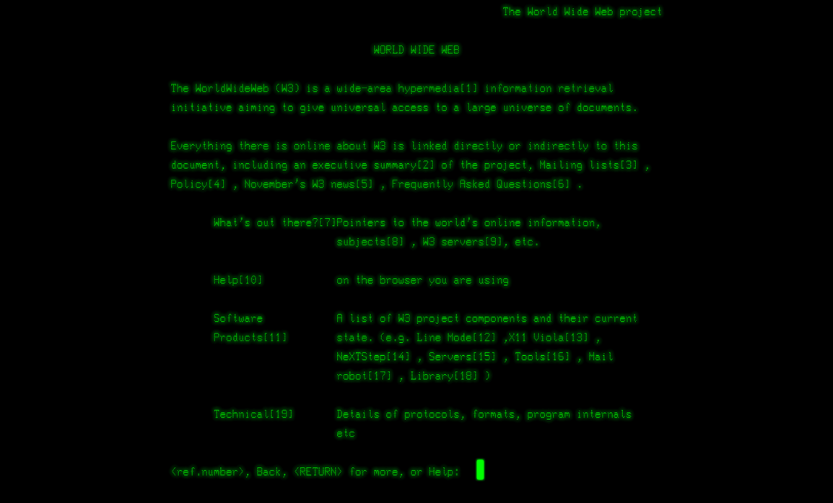
1991

Slide 4
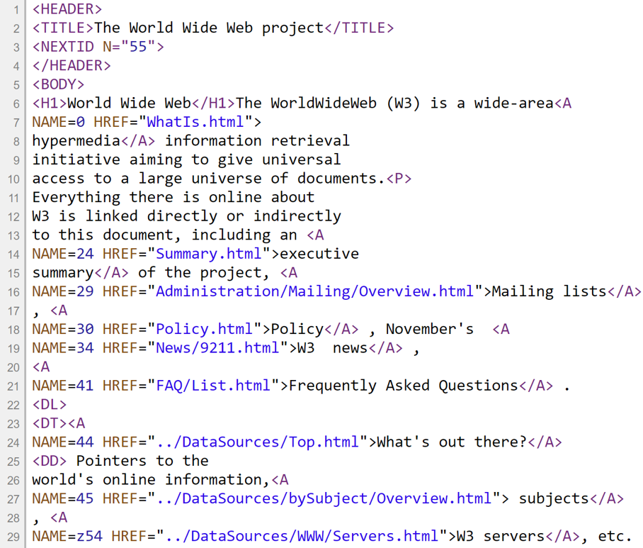
1991

Slide 5
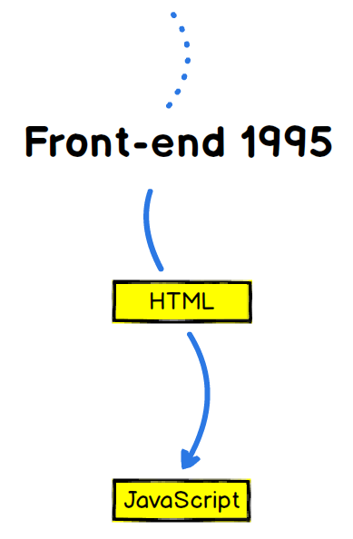

Slide 6
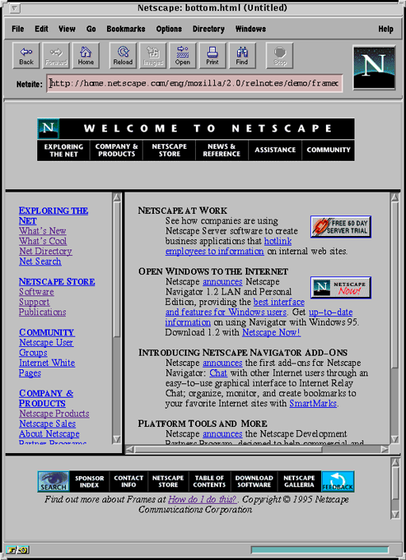
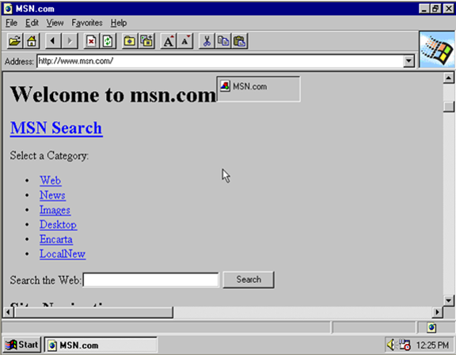
1995

Slide 7
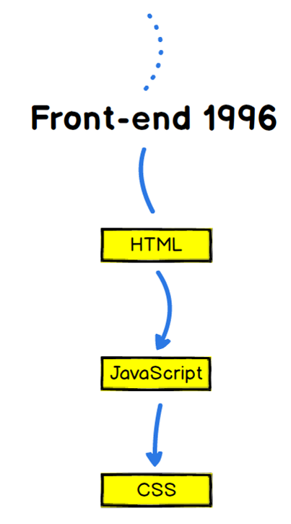

Slide 8

1996

Slide 9
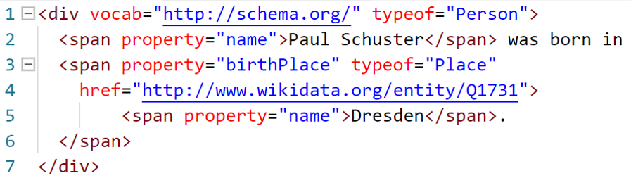
Sematic Web Markup

Slide 10
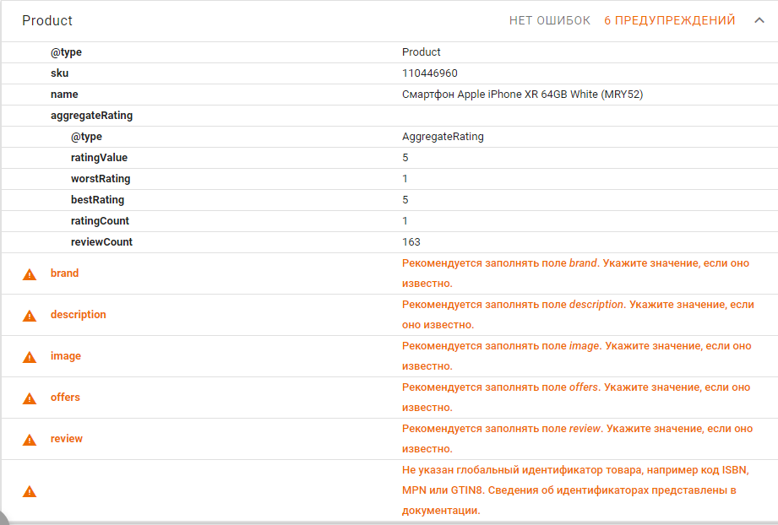
Test

Slide 11
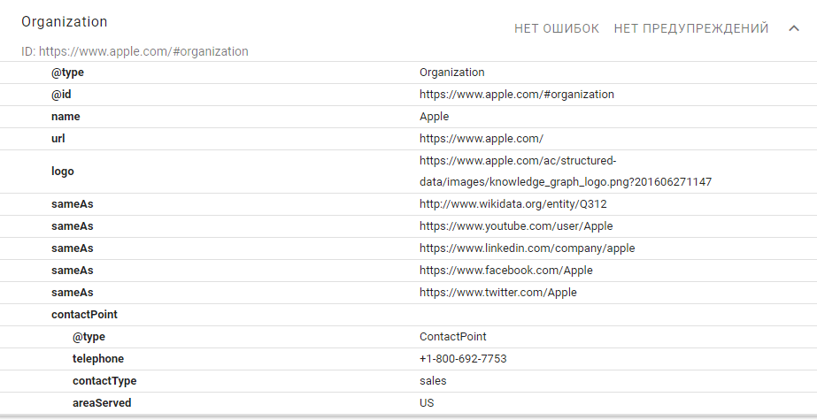
Test

Slide 12
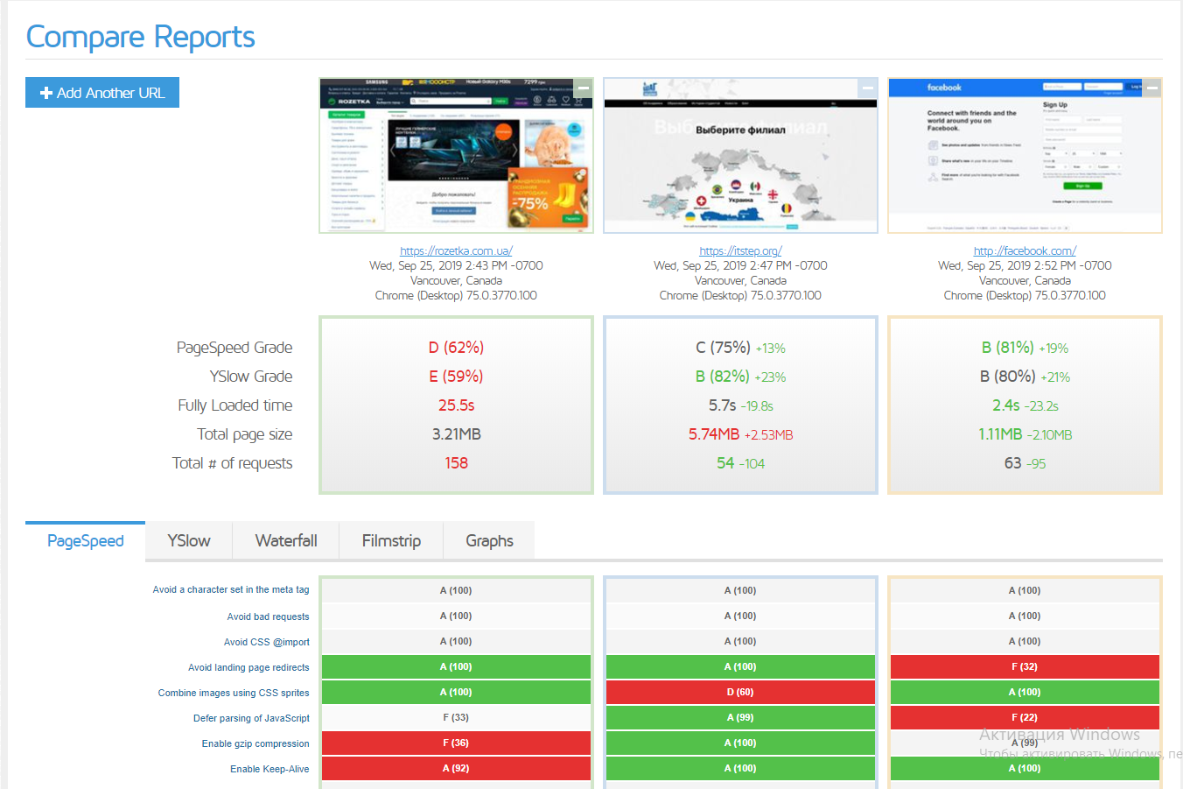
Compare

Slide 13
2008 – HTML5 Application
January 2008 – Working Draft
October 2014 – W3C Recommendation
Key points:
Multiple new APIs
Media support
RIA becomes obsolete
SPA boom has started

Slide 14
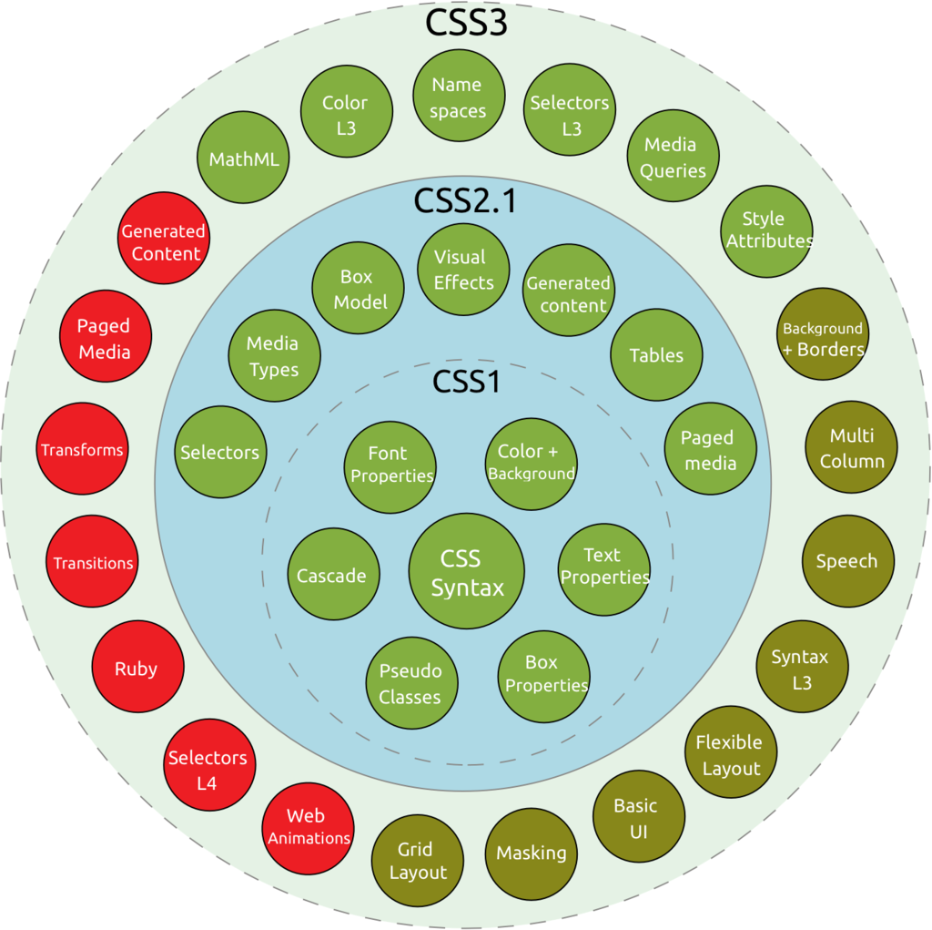

Slide 15
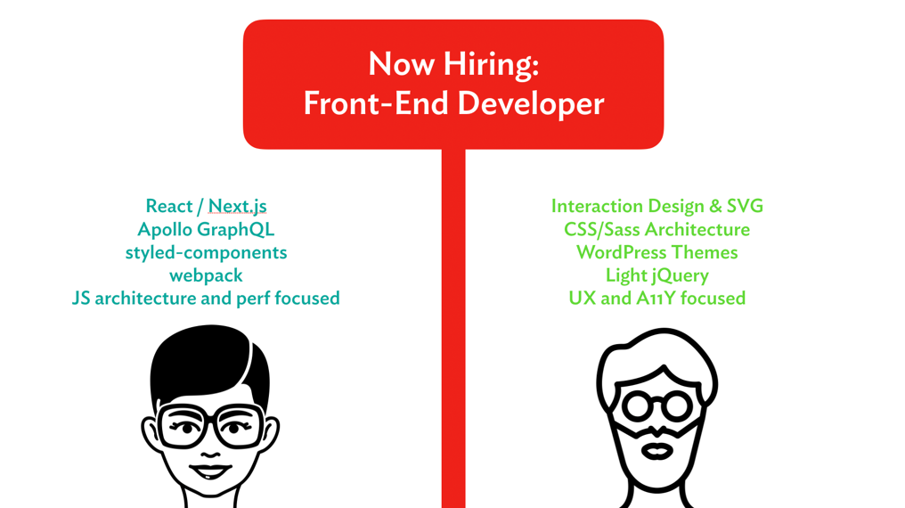
WHO IS FRONT-END DEVELOPER?

Slide 16


Slide 17

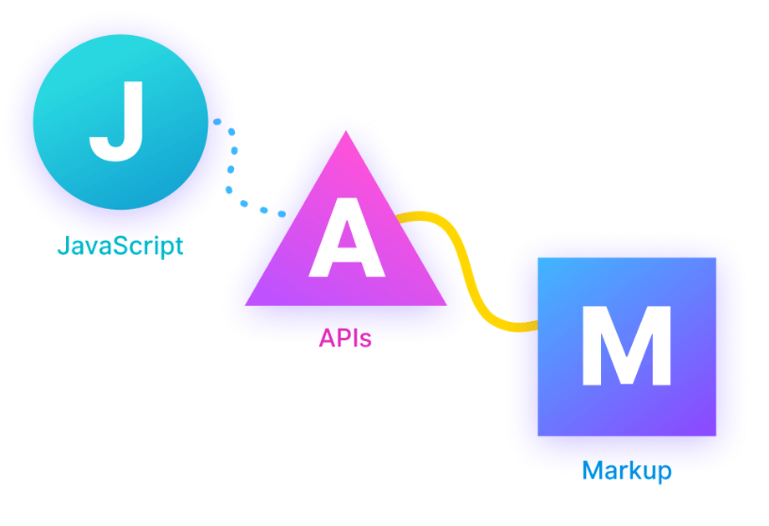

Slide 18
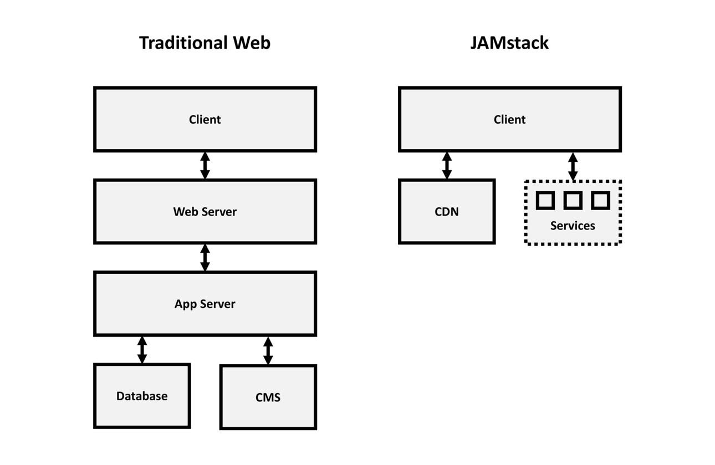

Slide 19
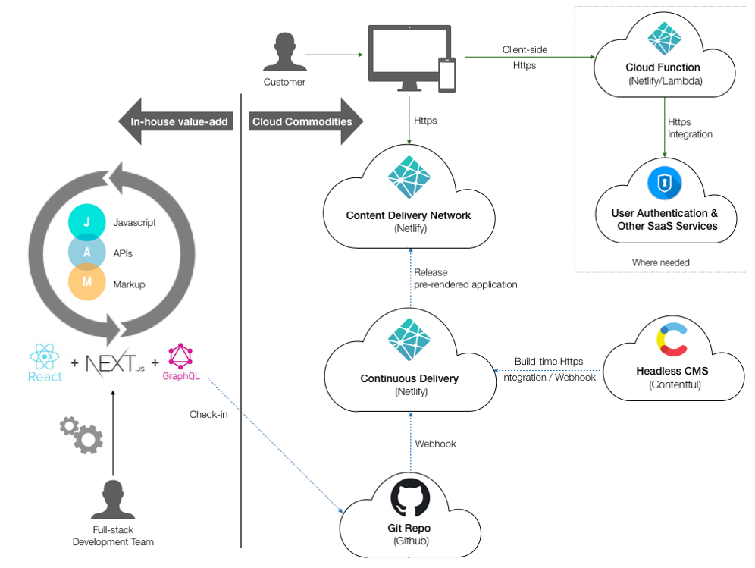

Slide 20


Slide 21
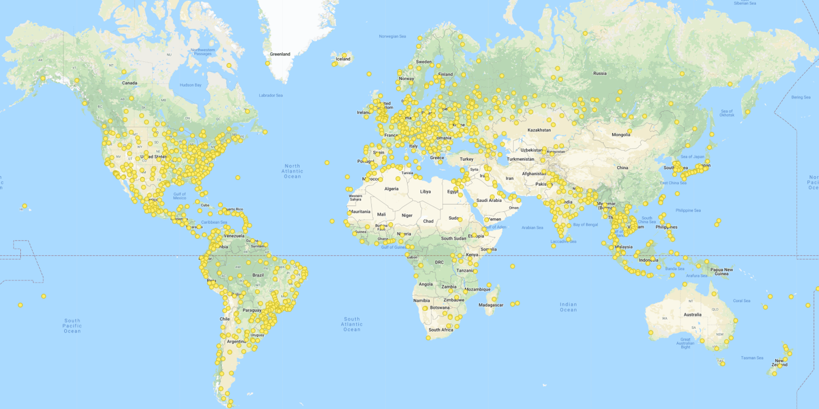
Google Cloud Global Cache

Slide 22
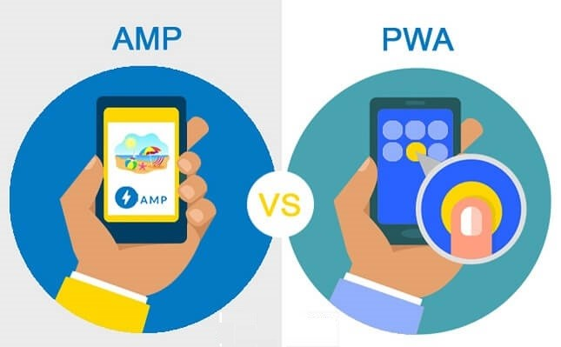

Slide 23
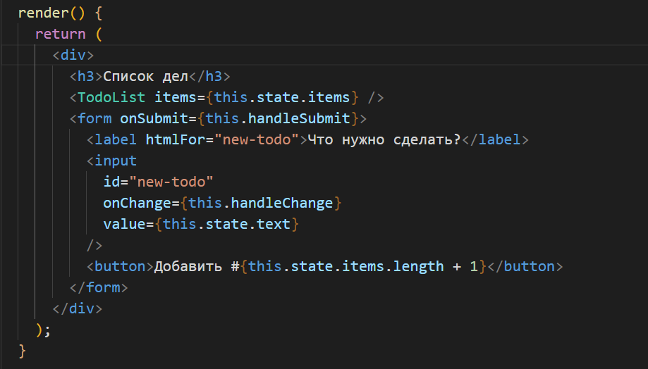
Reactive Programming?

Slide 24
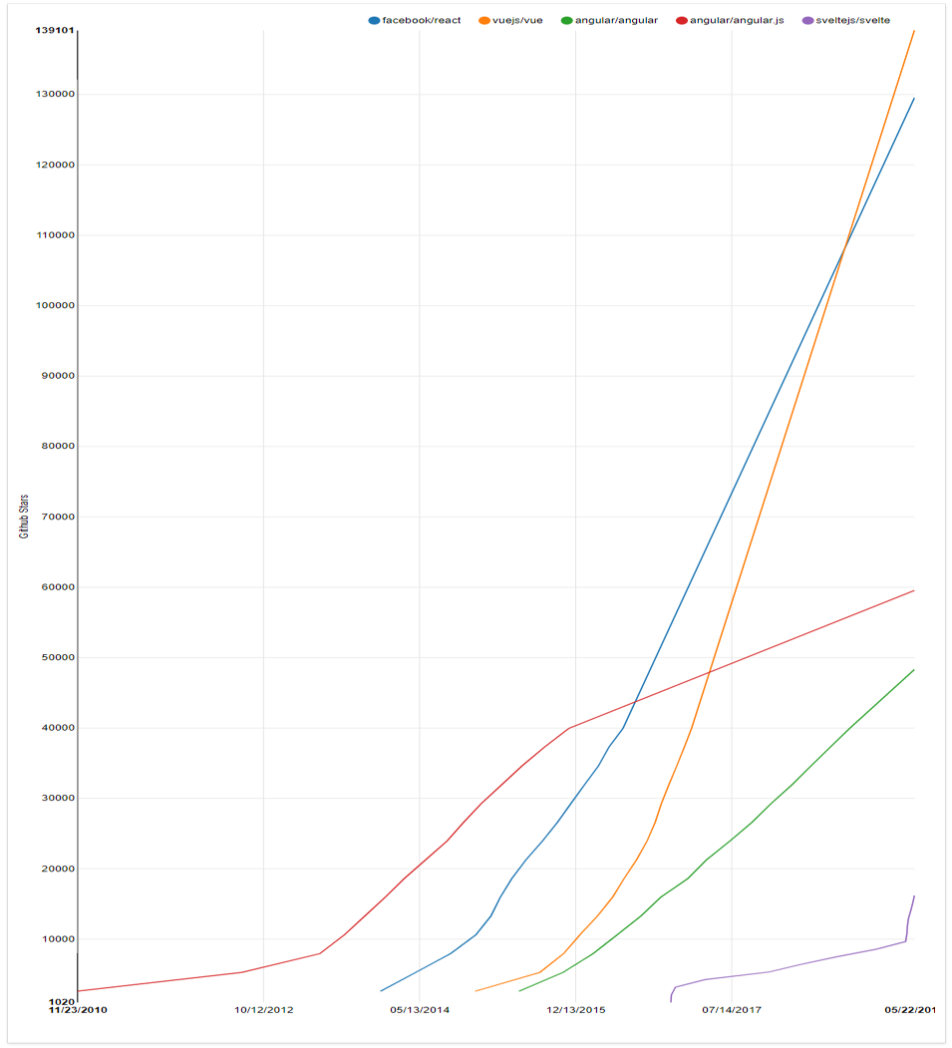
Single Page App

Slide 25
Demo

Slide 26
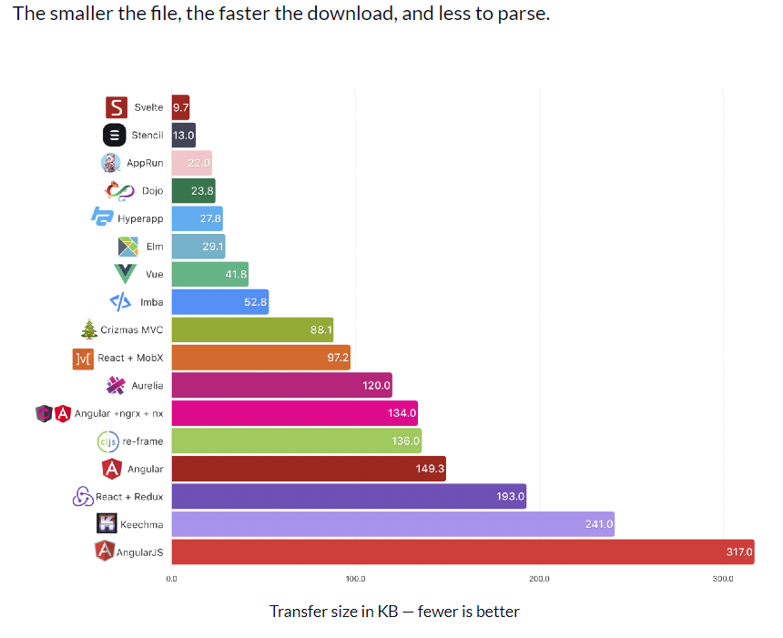

Slide 27
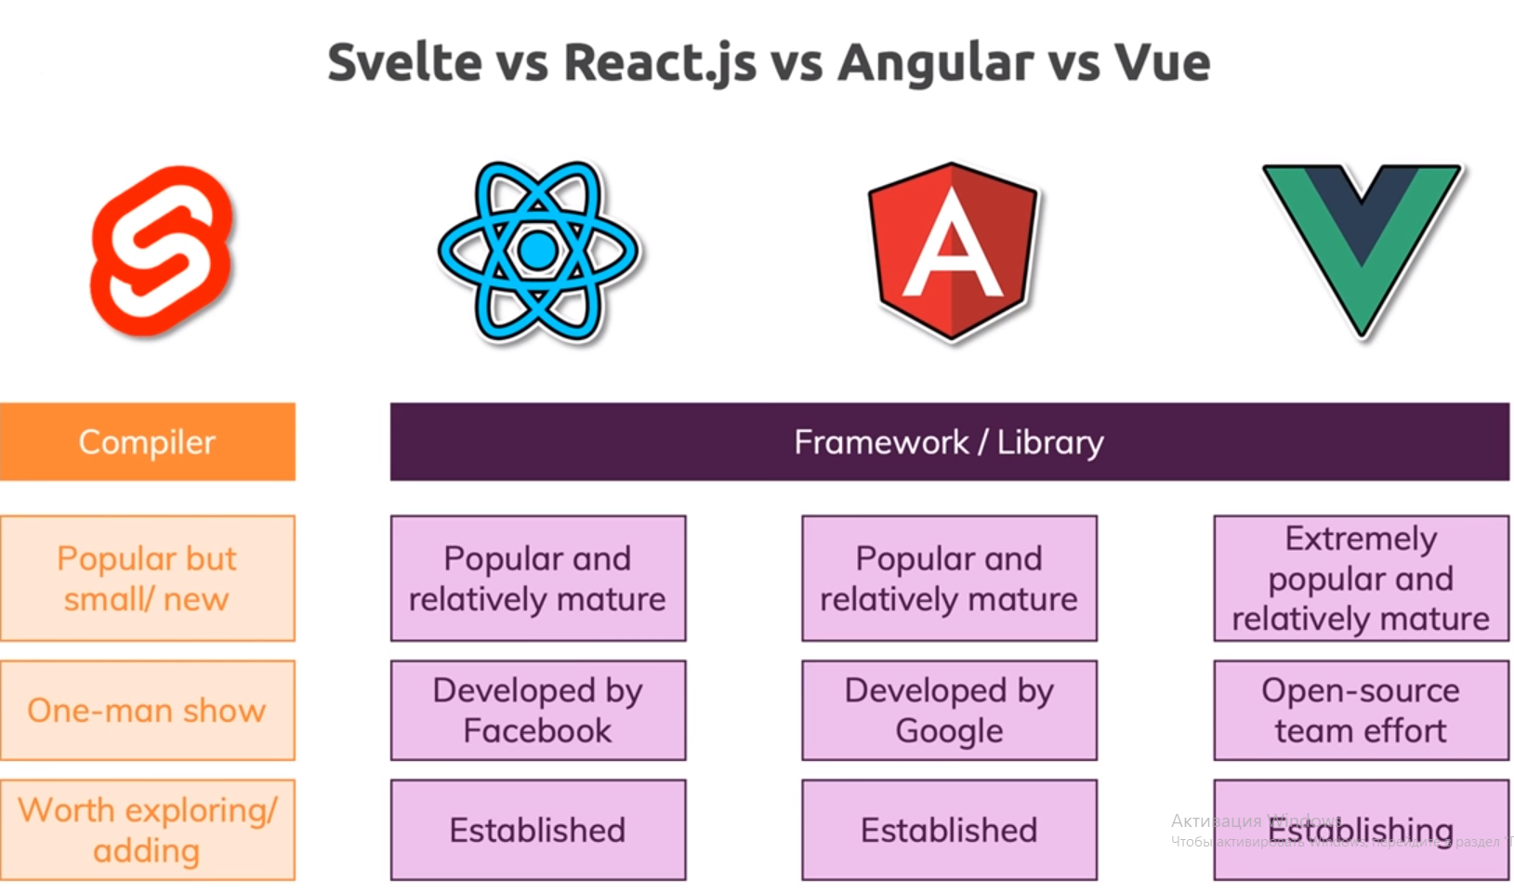

Slide 28
Q/A

